Slide 1
Using Machine Learning to Create Heatmaps on Valorant, and Using Image Processing to on Mousepad Weaving
App Physics 157 TX-1
Lance Clemente

Slide 2
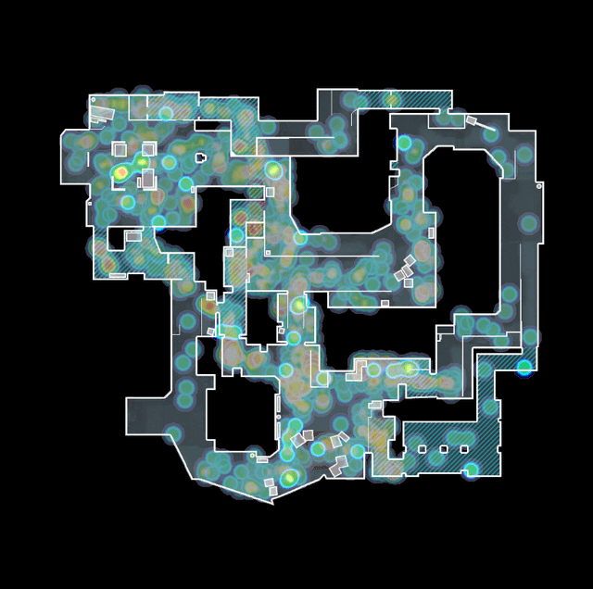
Background
Valorant VODs and Heatmaps
Compared to CS2,
Gets data directly from the game
Lack of available data in Valorant vs CS2
Workaround: VODs, and getting analytics from them instead
CS2 Heatmap of Deaths

Slide 3
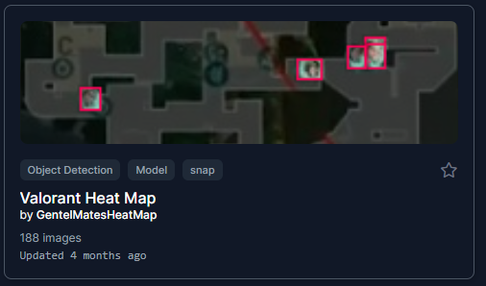
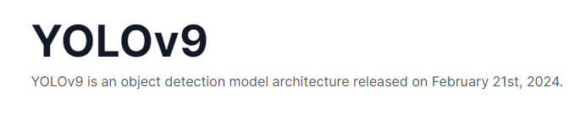
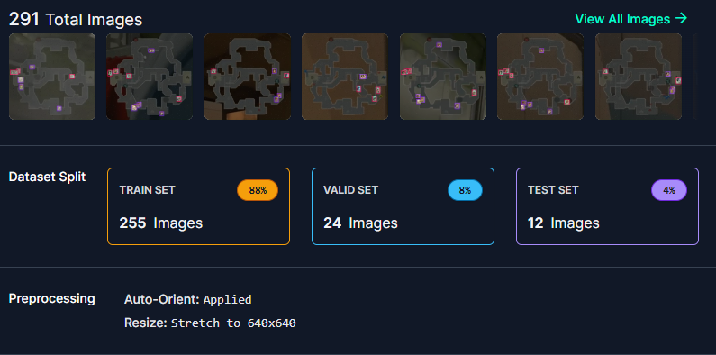
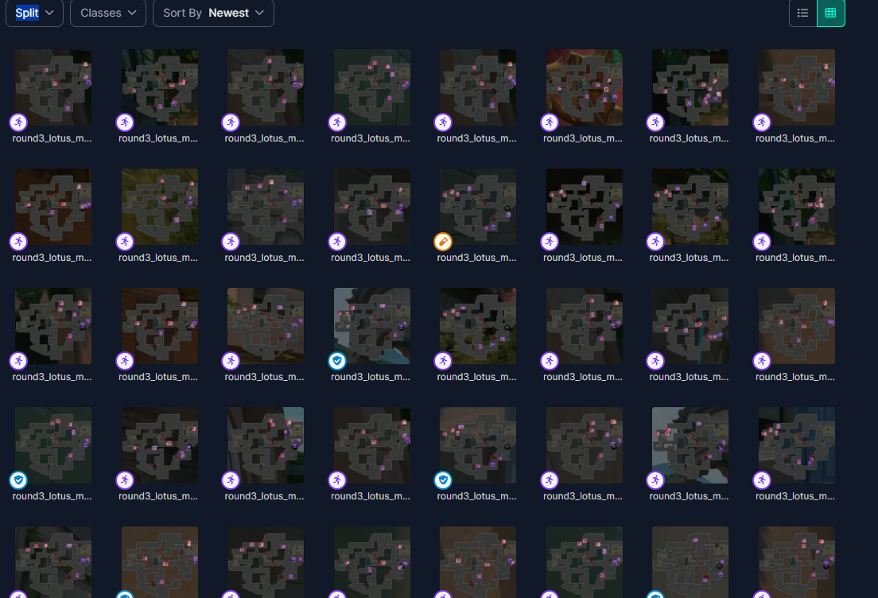
Method: Machine learning for object detection
Dataset from: https://universe.roboflow.com/gentelmatesheatmap/valorant-heat-map/dataset/2

Slide 4
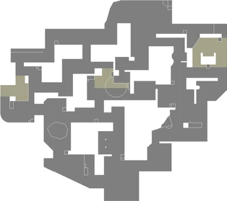
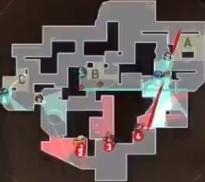
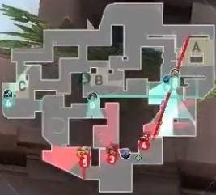
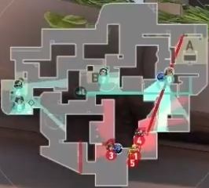
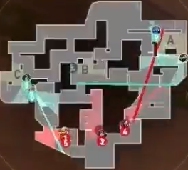
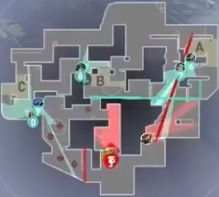
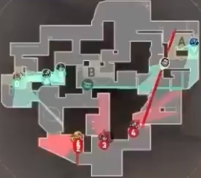
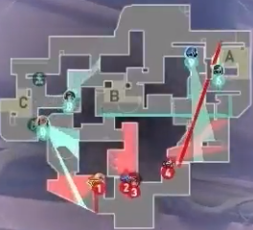
Method: Inputting personal data
Positions of all players at round start: Estudyante Esports, OBE (atk) vs MKL(def), Lotus

Slide 5
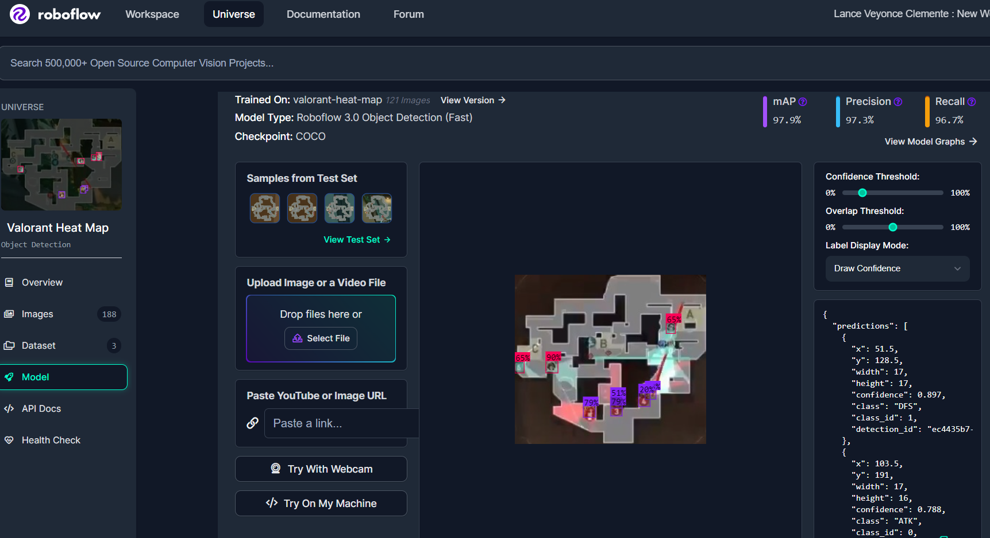
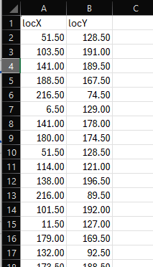
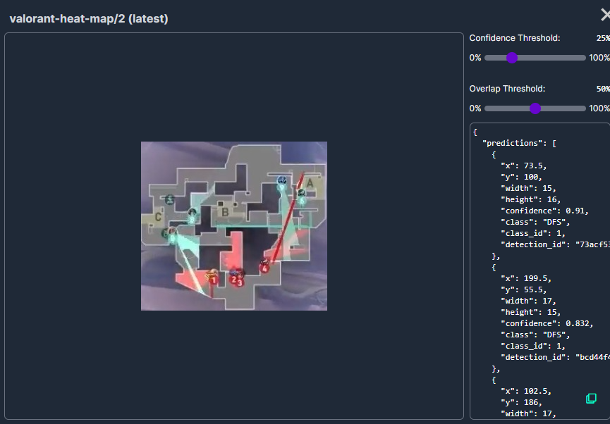
Method: Machine learning for object detection
https://universe.roboflow.com/gentelmatesheatmap/valorant-heat-map

Slide 6
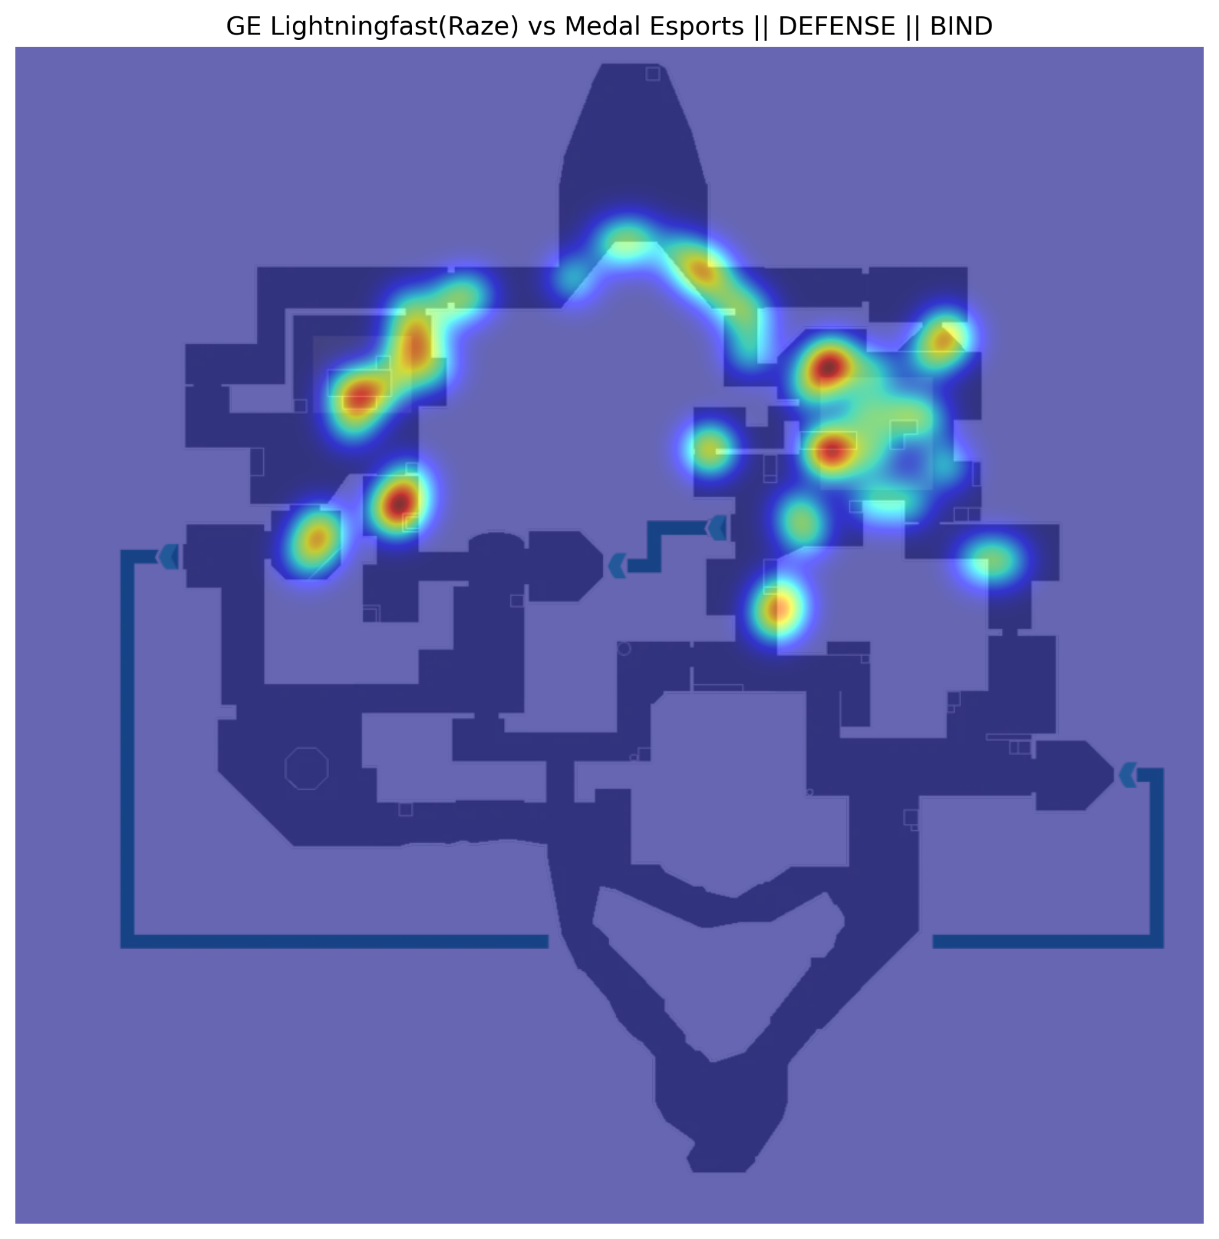

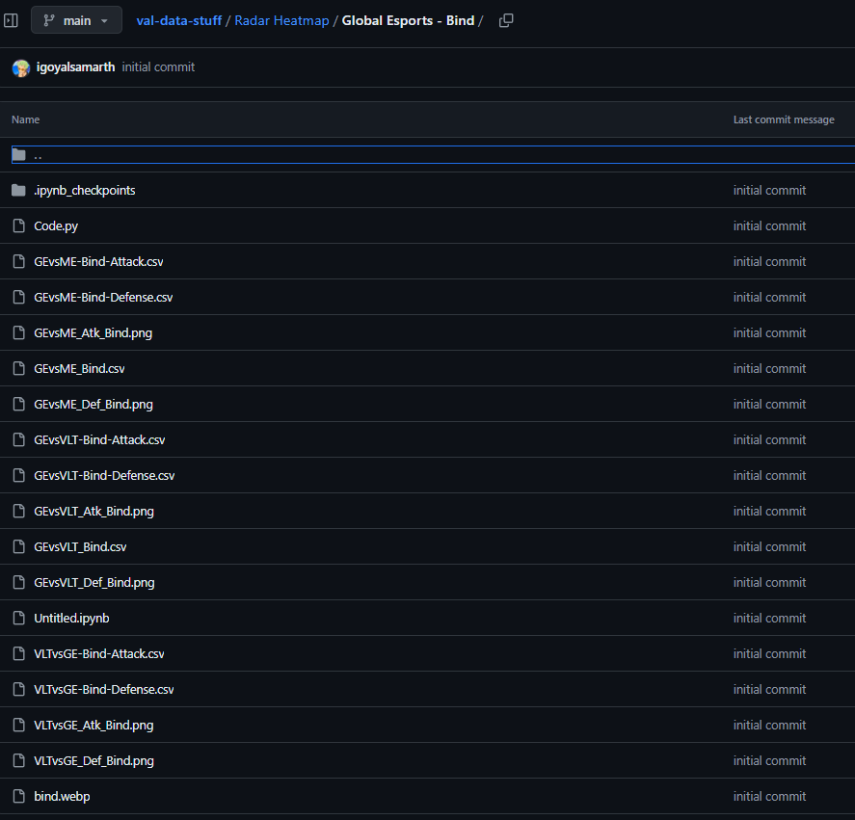
Material: Plotting values from object detection into heatmap

Slide 7
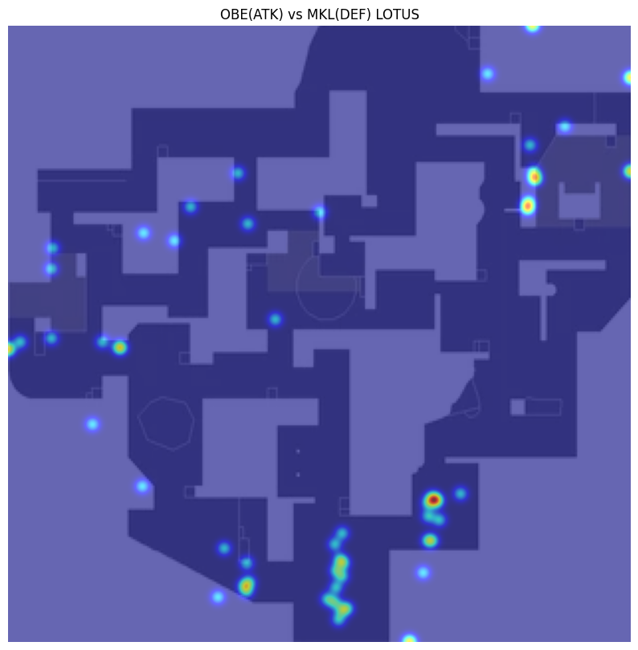
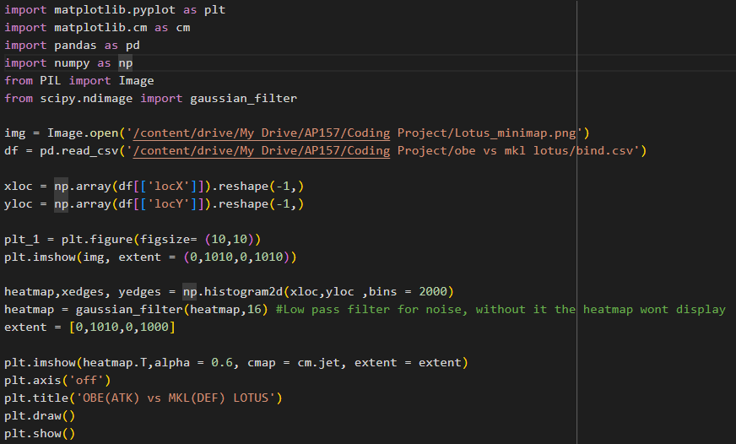
Result

Slide 8
Insight and Limitation
-Positions on heatmap do not land exactly on spots on map
-Inaccurate predictions of player positions
-Minimap Orientation

Slide 9
Conclusion
-Machine Learning allows for the formation of valorant heatmaps from the source of a minimap.
Recommendations:
-More Accurate Predictions (Bigger Dataset)
-More data not just showing positions at round start, can show during events in round(frags, deaths, etc.), Allows for more data analytics.

Slide 10
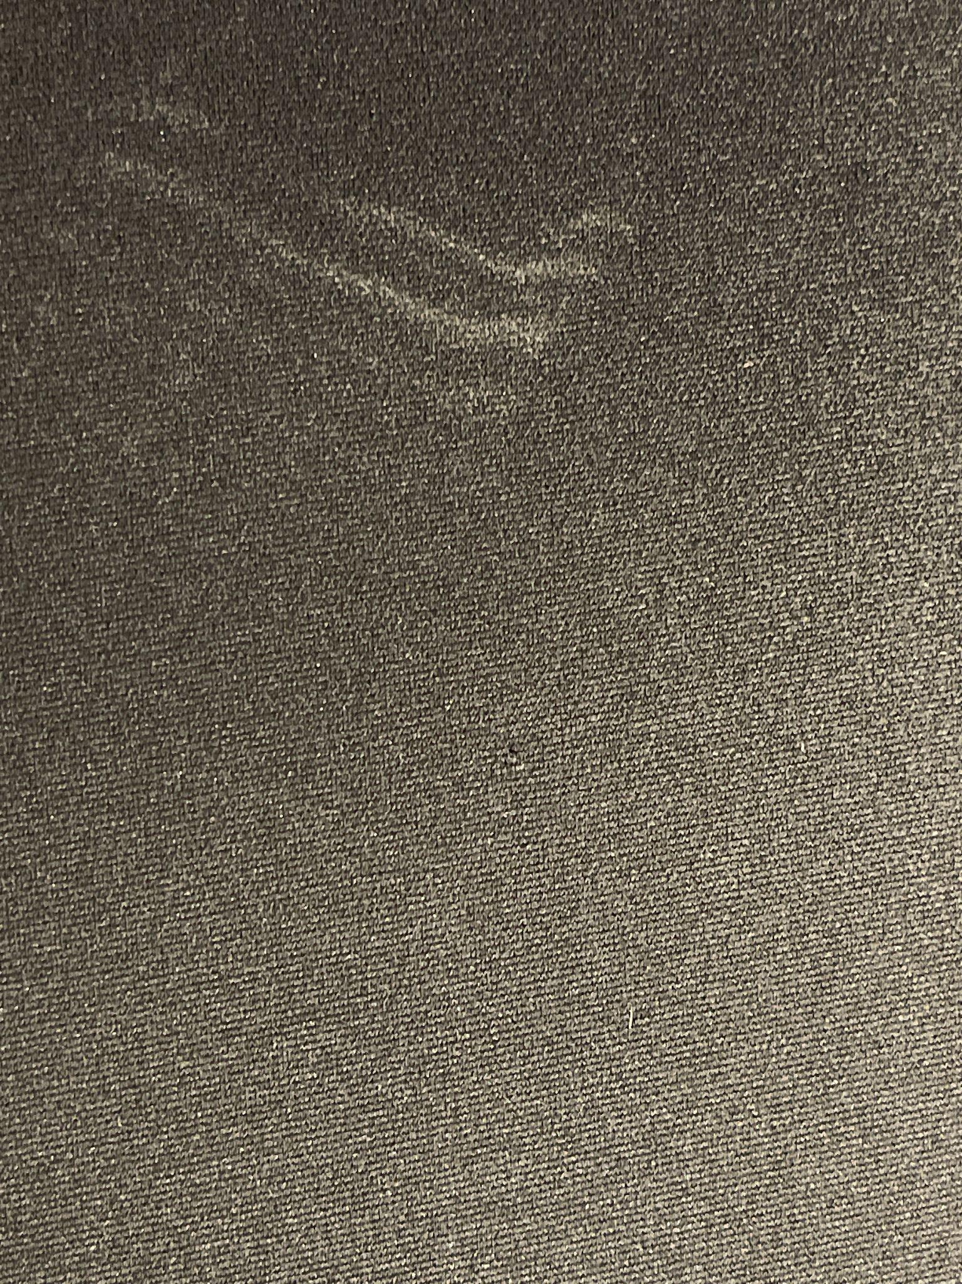
Background
Cloth mousepad
Used and Dirty
Has a woven cloth pattern
Similar to our Module B2 Lab Assignment
Observe the mousepad with the woven pattern filtered out

Slide 11
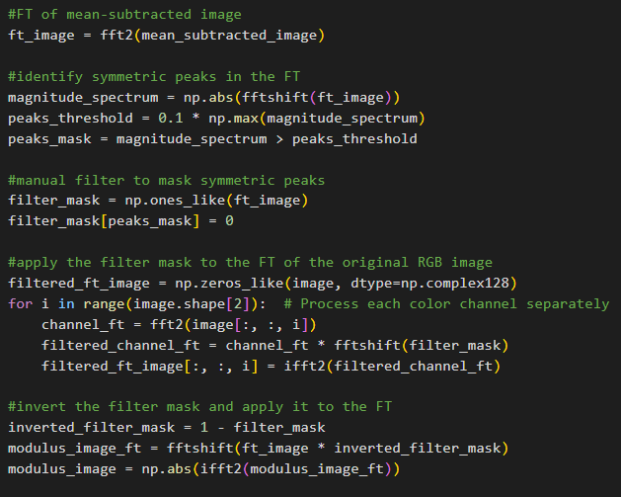
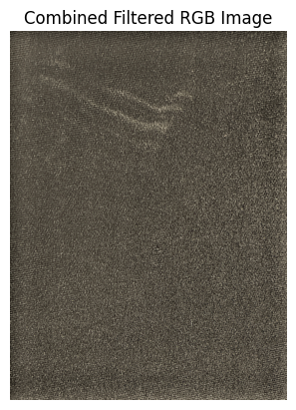
Method: Fourier transform pattern filtering
Greyscale & mean value
FFT
Identifying and Masking symmetric Peaks on FFTed RGB Channels of original image
Inverse FFT and observe The mousepad without the cloth weave.

Slide 12
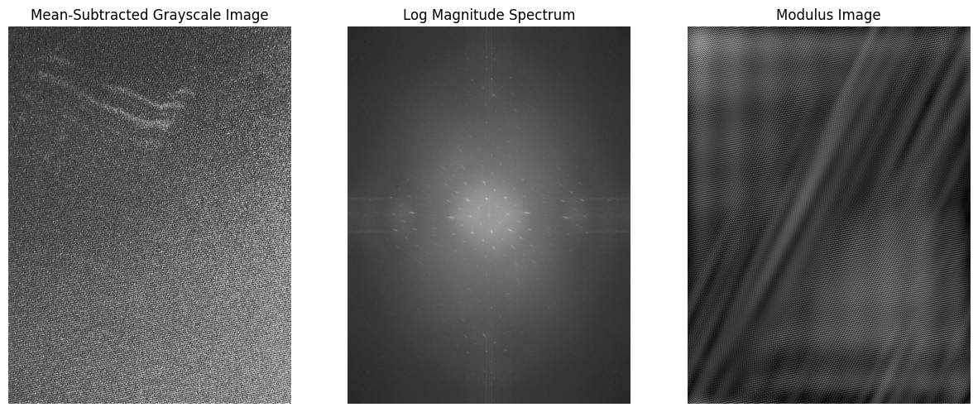
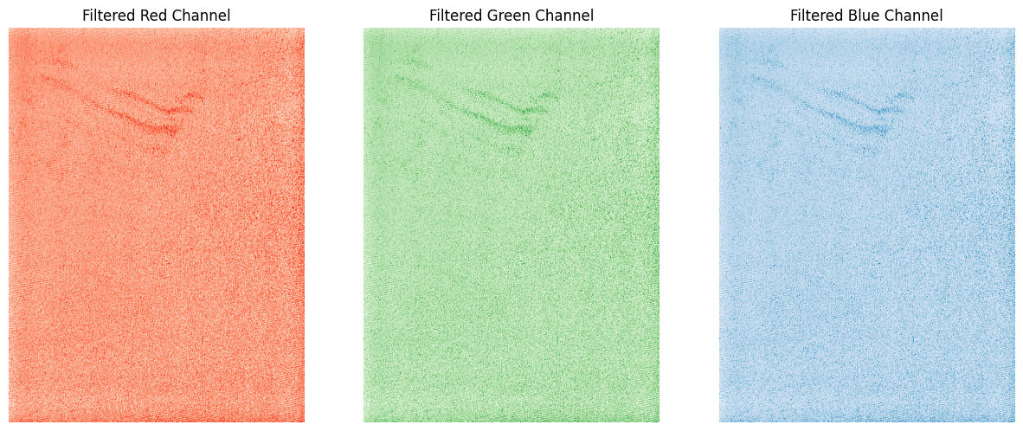
Method: Fourier transform pattern filtering
Greyscale & mean value
FFT
Identifying and Masking symmetric Peaks on FFTed RGB Channels of original image
Inverse FFT and observe The mousepad without the cloth weave.

Slide 13
Results: Pattern filtered out
Light shine on cloth pad was also filtered out.

Slide 14
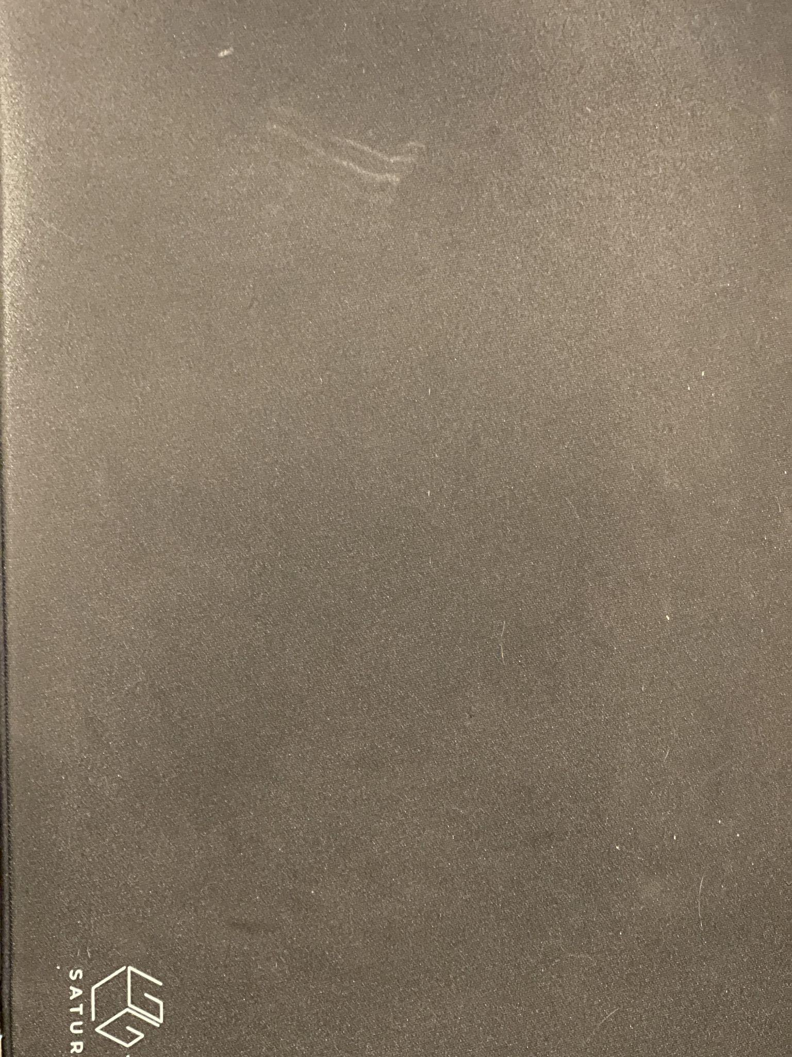
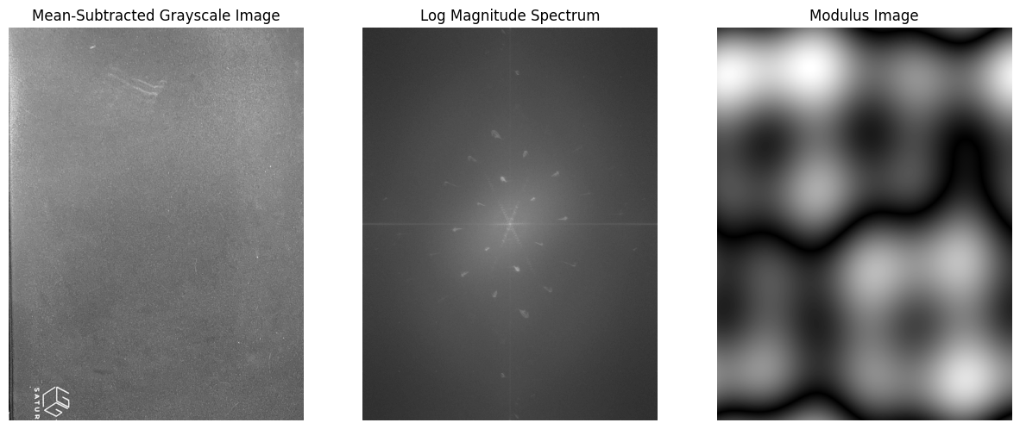
Limitations: Photo taken from afar, cloth pattern cannot be seen.

Slide 15
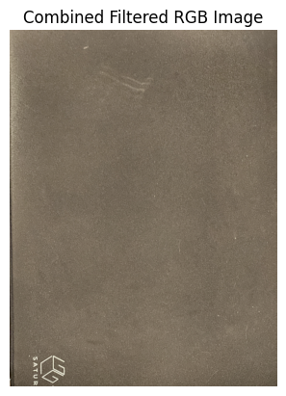
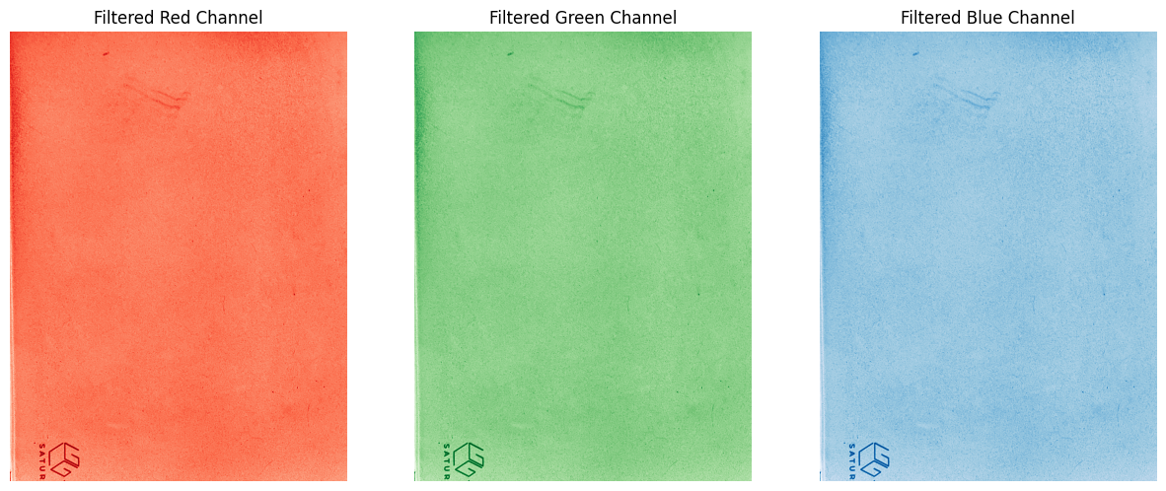
Limitations: Photo taken from afar, cloth pattern cannot be seen.

Slide 16
Recommendations
-identifies unusual objects on cloth/pattern
-can be used to see dirt on plain cloths

Slide 17
References
https://universe.roboflow.com/gentelmatesheatmap/valorant-heat-map/dataset/2
https://github.com/igoyalsamarth/val-data-stuff/tree/main/Radar%20Heatmap
https://docs.ultralytics.com/models/yolov9/

